Slide 1
Housing Price Prediction

Slide 2
Introduction
Housing and real estate market is one of the markets which is one of the major contributors in the world’s economy.
Data Science can help the companies increase their overall revenue, profits, improving their marketing strategies and focusing on changing trends in house sales and purchases.
Predictive modelling, Market mix modelling, recommendation systems are some of the machine learning techniques used for achieving the business goals for housing companies.

Slide 3
Objective
The company is looking at prospective properties to buy houses to enter the market.
Build a model using Machine Learning in order to predict the actual value of the prospective properties and decide whether to invest in them or not.
Which variables are important to predict the price of variable?
How do these variables describe the price of the house?

Slide 4
Data Info
1
Let’s start with Data Pre-processing

Slide 5
1168 Entries + 292 in Test Set
80 Feature
3 Float, Integer & 43 Categorical Features
The data has missing values

Slide 6
Imputation of Missing Values
Feature | Missing Values | Imputation Technique
Lot Frontage | 214 | Iterative Imputation
Alley | 1091 | Drop (Most of the entries are same)
BsmtQual | 30 | Replace with the category ‘NA’
BsmtCond | 30 | Replace with the category ‘NA’
BsmtExposure | 31 | Replace with the category ‘NA’
BsmtFinType1 | 30 | Replace with the category ‘NA’
BsmtFinType2 | 31 | Replace with the category ‘NA’
FireplaceQu | 551 | Replace with the category ‘No Fireplace’
Feature | Missing Values | Imputation Technique
GarageType | 64 | Replace with the category ‘NA’
GarageYrBlt | 64 | Replace with Property Year Buil
GarageFinish | 64 | Replace with the category ‘NA’
GarageQual | 64 | Replace with the category ‘NA’
GarageCond | 64 | Replace with the category ‘NA’
PoolQC | 1161 | Replace with the category ‘No Pool’
Fence | 931 | Replace with the category ‘No Fence’
MIscFeature | 1124 | Replace with category ‘No Feature’

Slide 7
Data Visualization – Univariate Analysis
2
Let’s start with our visualization on the dataset using Univariate Analysis Techniques

Slide 8
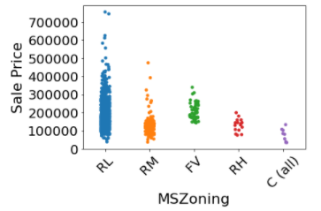
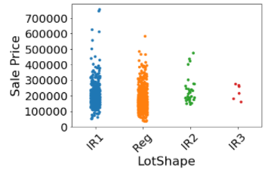
The decreasing order of starting price based on various zone is:
1-Residential Low Density
2-Floating Village Residential
3-Residential High Density
4-Residential Medium Density
5-Commercial
The minimum price of 'Moderately Irregular' and 'Irregular' shaped properties is higher than 'Regular' and 'Slightly Irregular' shaped.

Slide 9
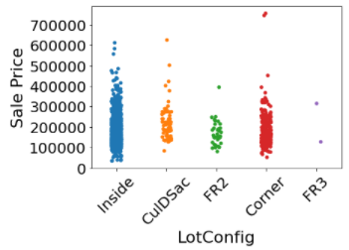
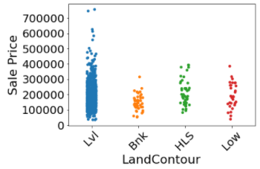
The minimum price of 'Hillside - Significant slope from side to side' properties is higher than other land contours.
The minimum price of 'Inside Lot' is least among all Lot Configuration.

Slide 10
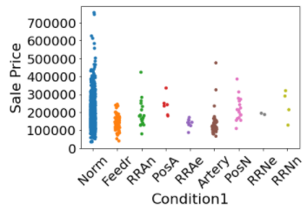
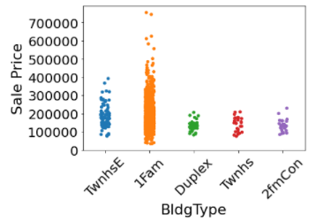
The minimum price of properties which are in close proximity to positive offsite feature like park, green belt, etc. or Within 200' of East-West Railroad is very high as compared to other properties.
The minimum price of properties whose dwelling type is Single-family Detached is the least.

Slide 11
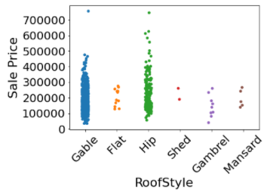
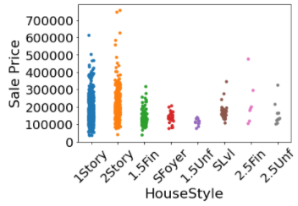
The minimum price of properties whose dwelling style is '2.5 Story' and 'Split Level' is very high as compared to '1 Story', '1.5 Story', '2 Story' or 'Split Foyer'.
The highest price of Flat, Shed, Gabrel(Barn) and Mansard is very less as compared to Gable and Hip.
The minimum price of properties based on roof type in decreasing order is:
1-Shed 2-Mansard 3-Flat
4-Hip 5-Gable 6-Gabrel (Barn)

Slide 13
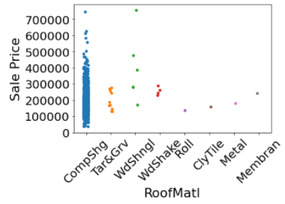
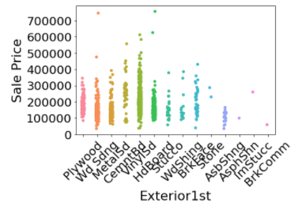
Majority of the properties are made up of Standard (Composite) Shingle.
The minimum price of the properties whose roof are made up of Wood Shakes is highest.
The minimum price of properties are in the lower range when the exterior covering is made up of Wood Siding, Vinyl Siding, Brick Face or Asbestos Shingles.

Slide 14
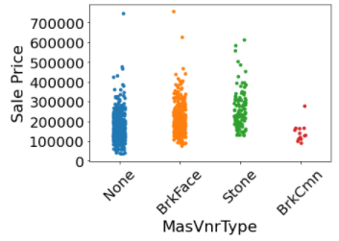
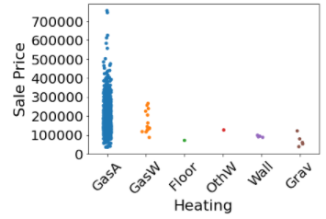
The minimum price is very high if the masonry veneer is of Stone.
Majority of the properties have Gas forced warm air furnace.

Slide 15
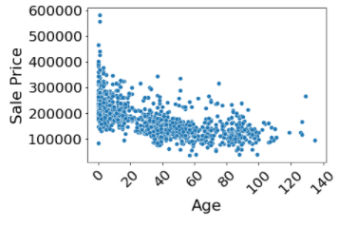
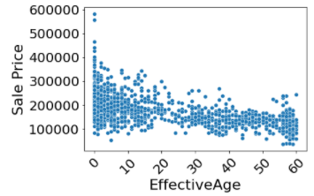
A new feature ‘Age’ is created from Year Built and Year Sold. The price decreases with the age of property
A new feature ‘EffectiveAge’ is created from Year Renovated and Year Sold. The price is usually decreases with the Effective Age off property.

Slide 16
Feature Selection
3
Identification of highly corelated features using HeatMap and Select K Best Technique

Slide 17
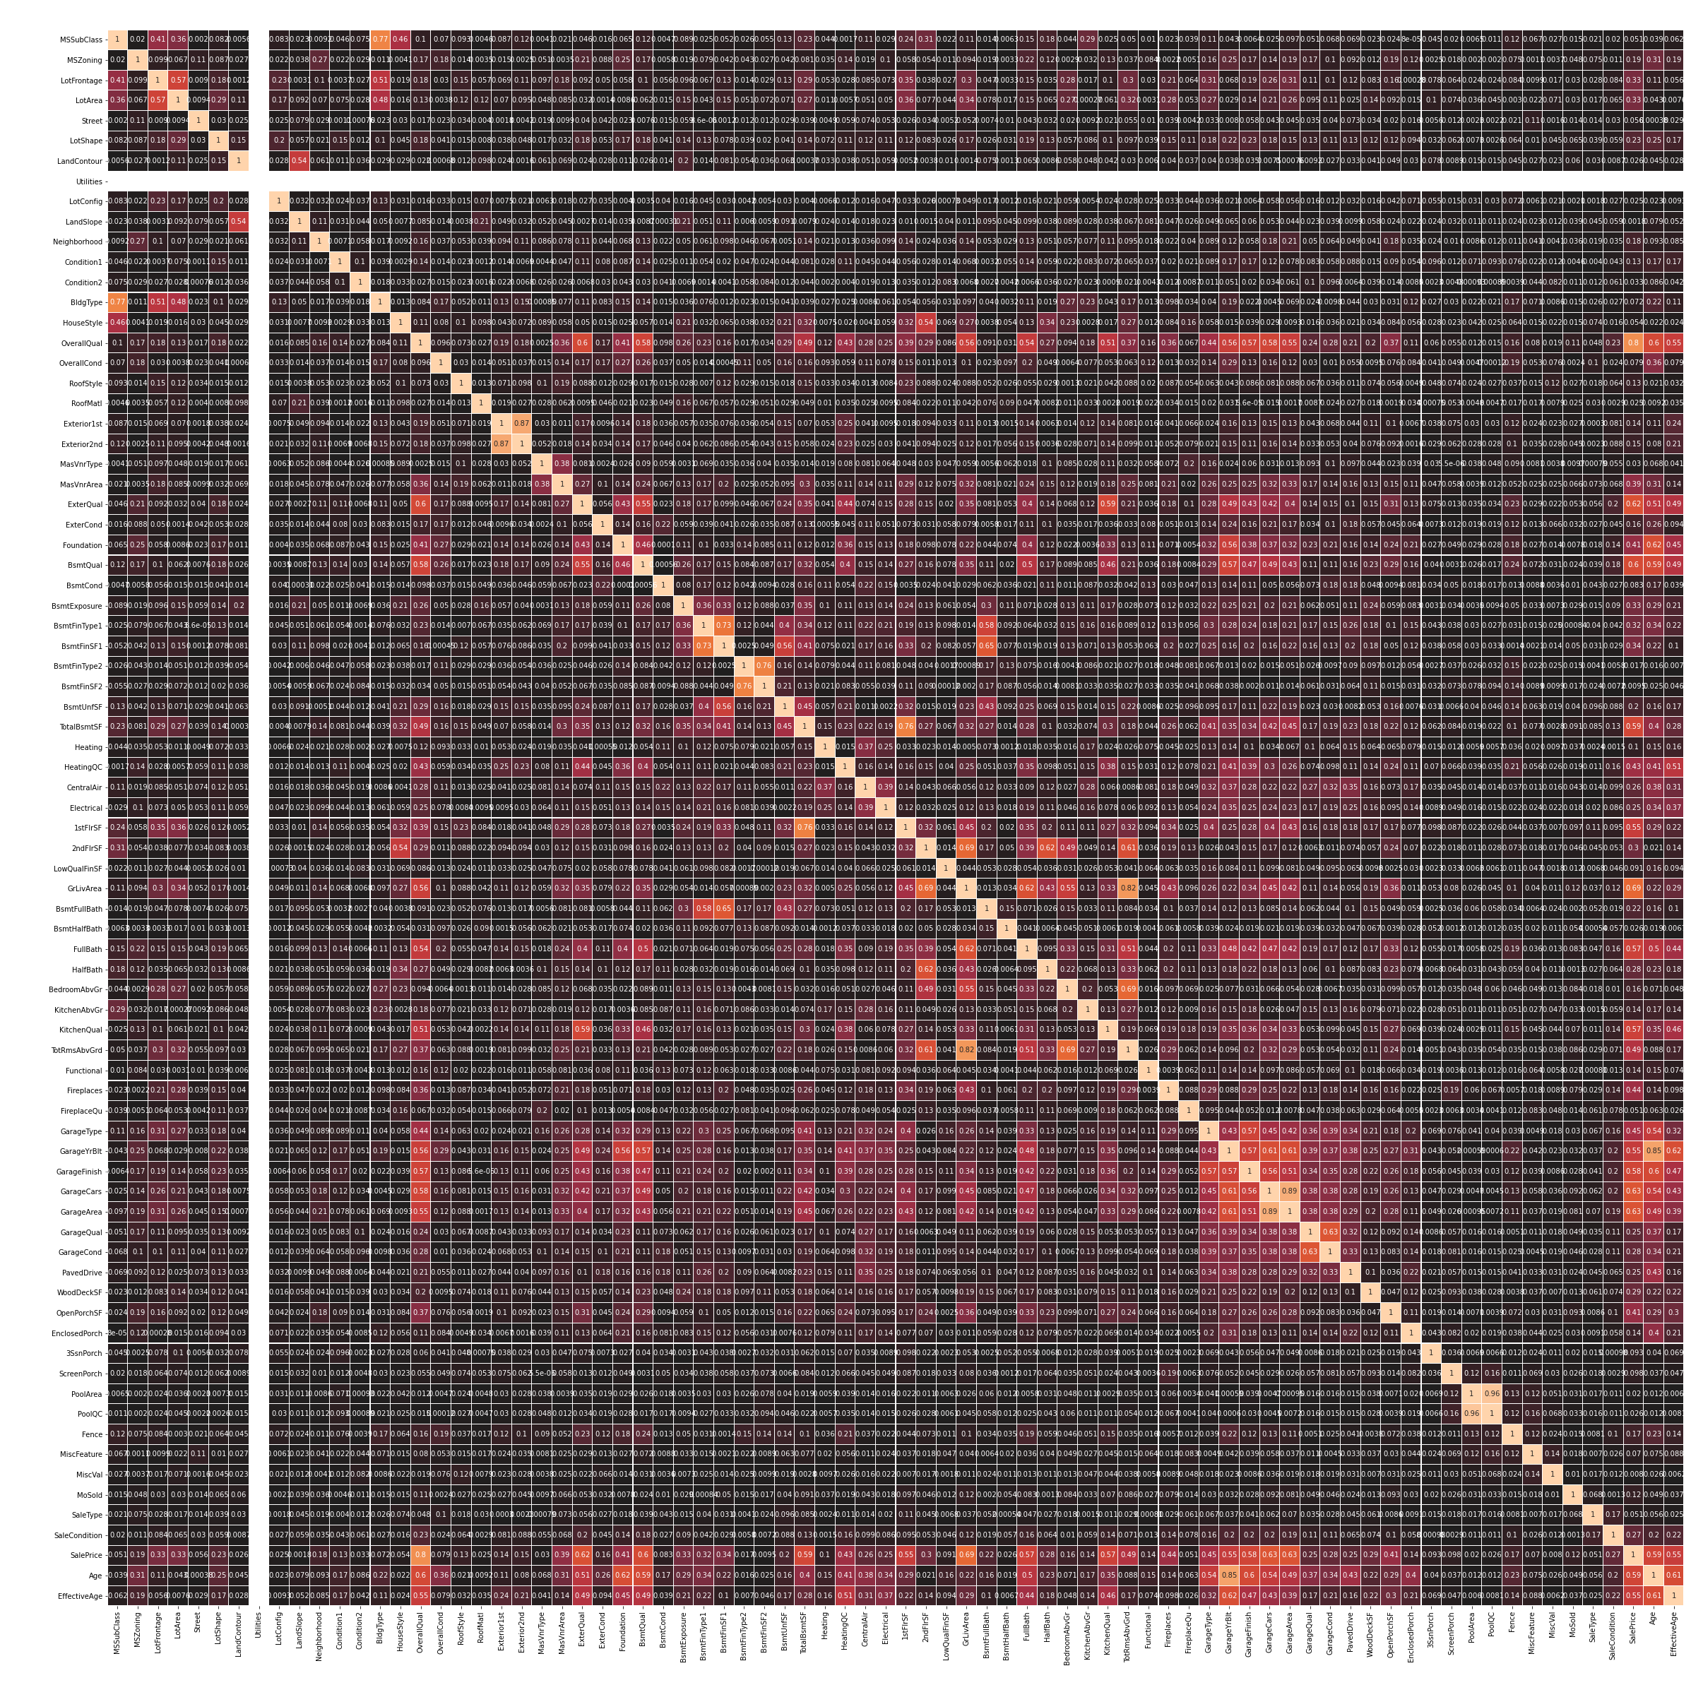
Analysis on Heat Map
The following features are highly correlated hence they are dropped from the dataset for improved accuracy of prediction.
'Exterior2nd‘
'GarageCars‘
'PoolArea'

Slide 18
Select K Best Feature Using the Select K Best Technique the first 25 features which decide the price are
OverallQual
MiscVal
ExterQual
GrLivArea
GarageArea
KitchenQual
GarageFinish
FullBath
BsmtQual
Age
TotalBsmtSF
GarageYrBlt
1stFlrSF
EffectiveAge
MSZoning
Heating
Street
BsmtFinSF1
MasVnrArea
GarageType
Foundation
Fireplaces
CentralAir
TotRmsAbvGrd
OpenPorchSF

Slide 19
Model Fitting and Tuning
4

Slide 20
Performance of Models
S. No. | Model Name | MSE
1. | Linear Regression | 23975
2. | Lasso | 23971
3. | Ridge | 23944
4. | KNN | 37154
5. | Decision Tree | 35772
6. | Random Forest | 25153
7. | Ada Boost | 30270
8. | Gradient Boost | 21713
5. | XG Boost | 23723

Slide 21
Performance of Models after Tuning
S. No. | Model Name | Score
1. | Decision Tree | 0.76
2. | XG Boost | 0.89
3. | Random Forest | 0.86
4. | Gradient Boost | 0.88

Slide 22
Conclusion

Slide 23
Based on our analysis the XG Boost Regressor predicted the house of properties.
We cleaned the data, performed EDA and successfully trained a model and tuned the hyper parameters to predict the price of properties based on the features and dataset available with us. The XG Boost Regressor proved to be the best model in terms of score and performance.
Score – 0.89
MAE – 14390
RMSE – 21176
Hyper Parameters – {max_depth=5, learning_rate=0.1, min_child_weight=7, gamma=0.4, colsample_bytree=0.3}

